Slide 1
How to Get the Most out of Your Workout

Slide 2
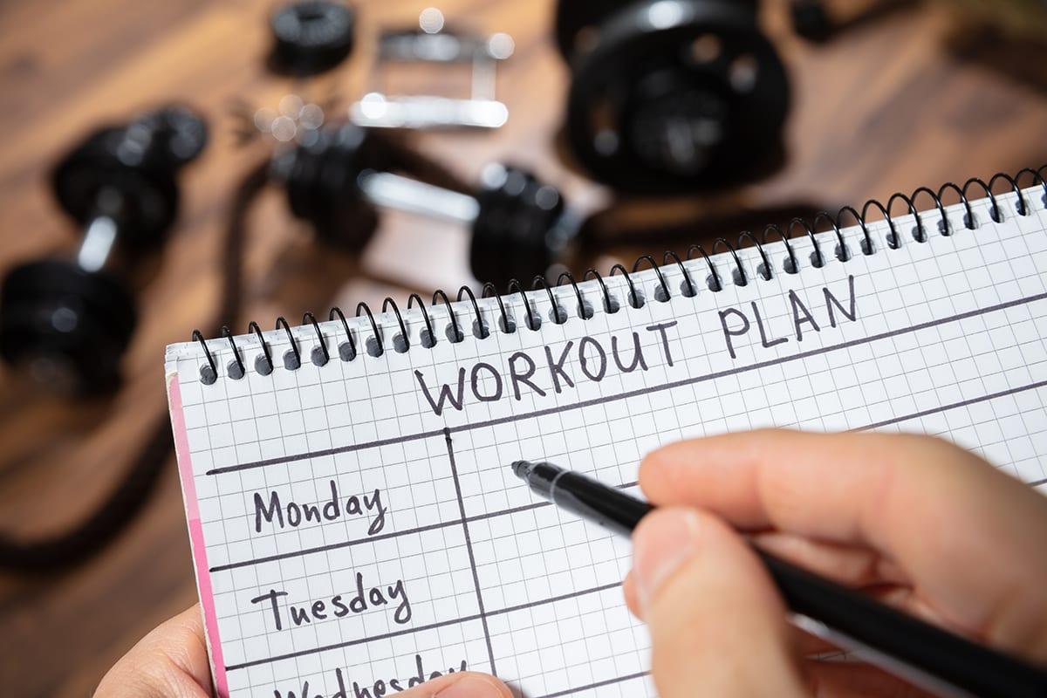
Planning
When?
Cardio or Weights?
Which Muscle Groups?

Slide 3
Preparation
A Great Sleep
Comfortable and Confident Clothes
Eating Before Working Out

Slide 4
During-Workout
Get the Music going
Stay Hydrated
Limit time in Between sets

Slide 5
Post-Workout
Stretch out those Muscles
Eat a High Protein Meal

